Slide 1

Problem Solving Session
The remainder of today’s class will comprise the problem solving session (PSS).
Your instructor will divide you into teams of 3 or 4 students.
Each team will work together to solve the following problems over the course of 20-30 minutes.
You may work on paper, a white board, or digitally as determined by your instructor.
You will submit your solution by pushing it to GitHub before the end of class.
Your instructor will go over the solution before the end of class.
Write your name on each completed sheet.
Submit to the designated MyCourses’ Dropbox.
Class participation is a significant part of your grade (20%). This includes in class activities and the problem solving session.
Your graders will grade your participation by verifying that you pushed your solutions before the end of the class period each day.

Slide 2
Problem 1
Arya
Name: Arya Sharad | Prior Experience (0-10): 2
Comments: I don’t have much experience with computer languages and coding as I didn’t study computer science in my 11th and 12th grade.
Software Development & Problem Solving is designed for students of all levels of experience. There are students in this classroom with little or no programming experience, students who have been coding for years, and every skill level in between.
Spend a few minutes talking with your team members about your prior experience with programming (in any language, not just Python).
Rate yourselves on a scale of 0 (very little or no experience) to 10 (you should be teaching this class!).
Fill out the tables with each of your answers.
Name: Amaal Nuha Mecci | Prior Experience (0-10): 6
Comments: Coded basic programs on python, studied it in IGCSEs to A levels
Name: Rashed Alsuwaidi | Prior Experience (0-10):
Comments: 0 years experience
Name: Osama Ismail | Prior Experience (0-10): 3
Comments: Took a couple classes in high school but they were really basic
If you are working digitally and need more space, duplicate this slide.

Slide 3

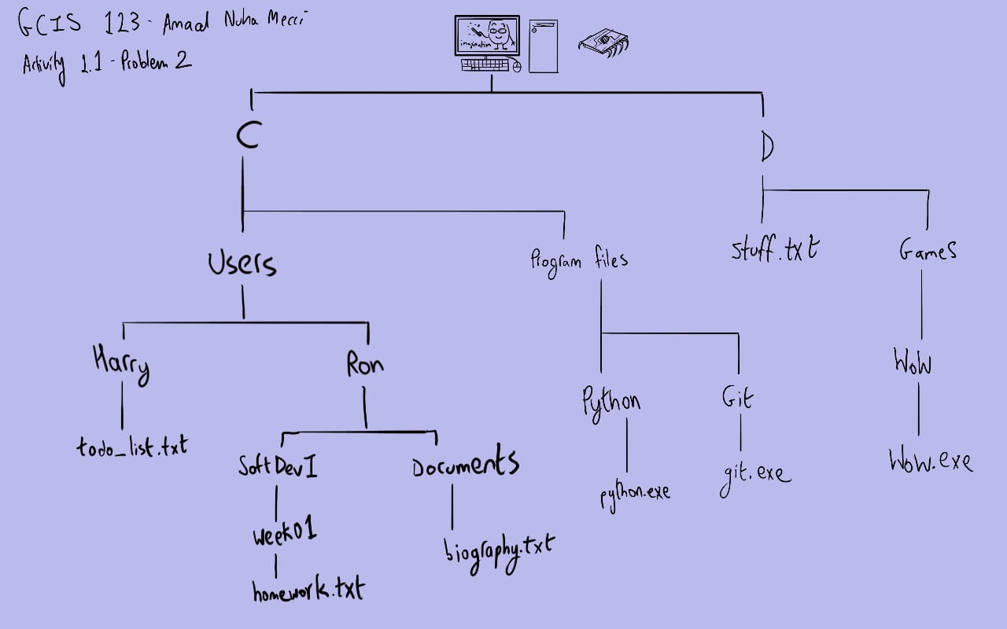
Problem 2
Arya
File
Dir
X:
Files in the file system are organized into a tree structure. Visualizing this structure can make finding files and directories more intuitive.
Assume that each of the following is an absolute path to a file in your file system. Draw the tree that represents the structure in the space on the left.
Your instructor will determine if you should work digitally, on paper, or on a whiteboard. Use the icons to the left as references.
C:\Users\Ron\Documents\biography.txt
C:\Users\Ron\SoftDevI\Week01\homework.txt
C:\Users\Harry\todo_list.txt
C:\Program Files\Python\python.exe
C:\Program Files\Git\git.exe
D:\Games\WoW\wow.exe
D:\stuff.txt

Slide 4
Problem 3
Arya
1. Created a new text file in the repository.
2. Informs git to add update to the staging area.
3. Saves the progress and informs team members of the changes made.
4. Publishes the code in the cloud and brings it back to the mainstream.
5. Same fuction as the first one and adds name to the file.
Understanding the status of the files in your repository is important! Have you made changes to any files that need to be committed? What has been added, modified, deleted, or staged since your last commit?
Consider the following commands executed in a Git repository on your computer. Together with your team, describe the status of the file at each step.
notepad new_file.txt
git add new_file.txt
git commit -m "adding a new file"
git push
notepad new_file.txt (add text)

Slide 5
Problem 4
Arya
1. To confirm our changes have been saved after a successful test in order to upload the updated version to the cloud.
2. The first thing we do when starting a brand new assignment is creating a new repository and cloning it into our local hard drive.
3. Saving and uploading the work done to the remote repository.
4. Log in to our github account from the different computer, get your access key and clone the file.
Proper use of version control means understanding why we use it and not just memorizing how to use it.
Discuss the following questions with your team, and type or write your answers in the space on the right.
Why do you think that it is a good idea to check the status before staging files?
When starting a brand new assignment, what is the first thing you should do, and why?
What is the last thing that you should do before taking a break from working?
Assume that you are getting back to work on a different computer. What is the first thing you should do?

